Slide 1



disaster recovery

Slide 2
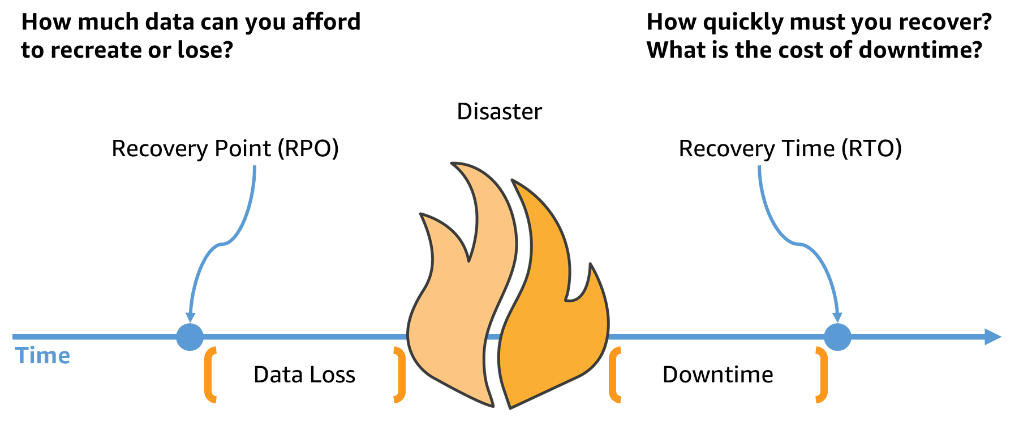
RPO / rto

Slide 3
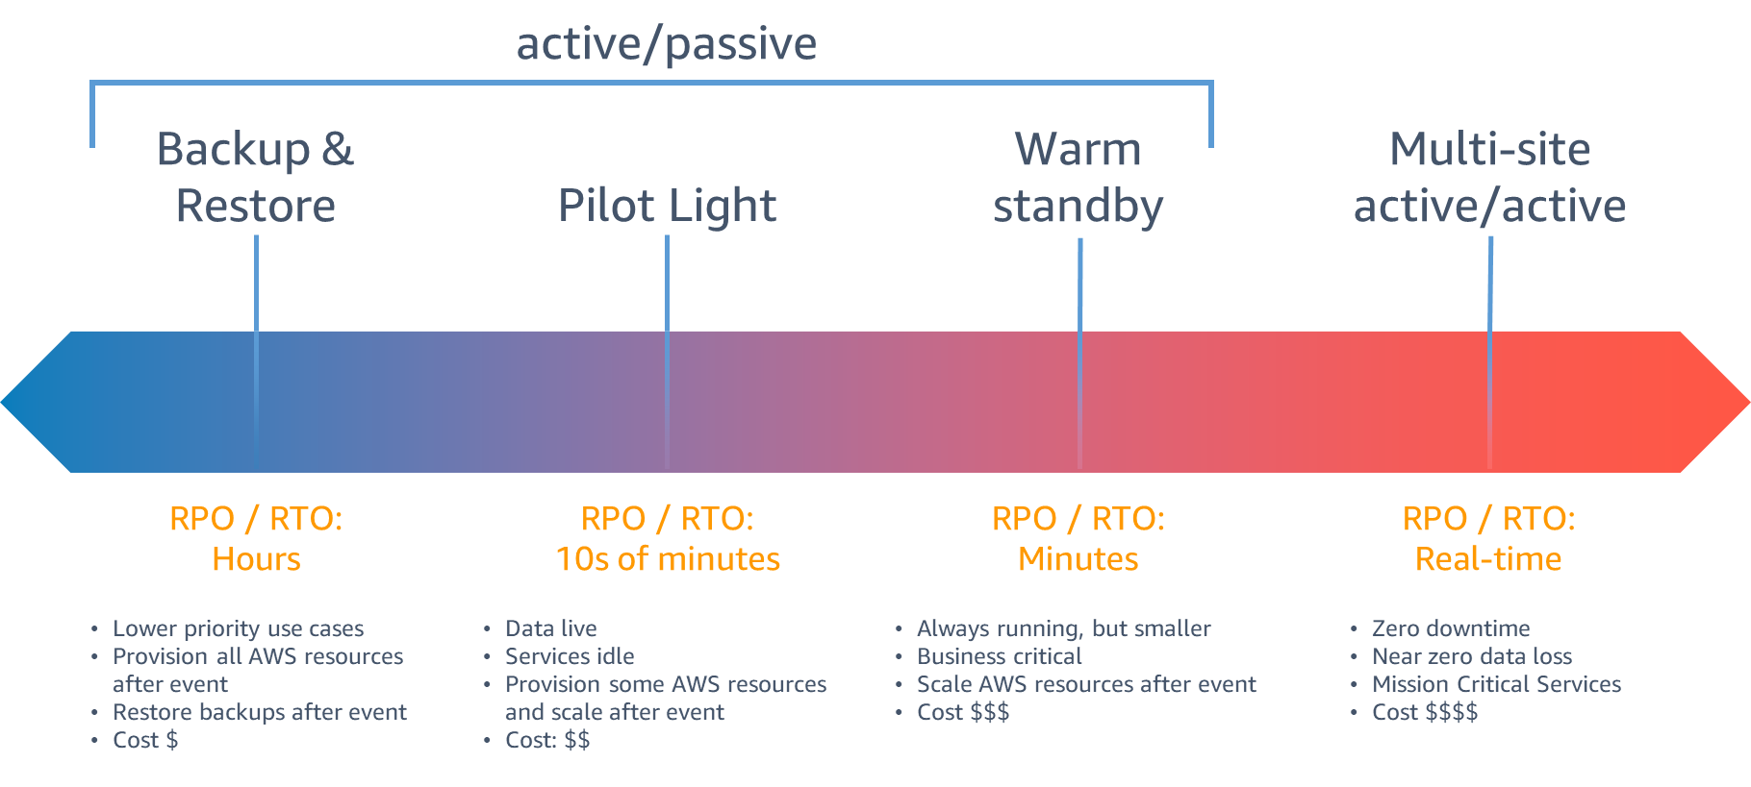
Backup strategies

Slide 4
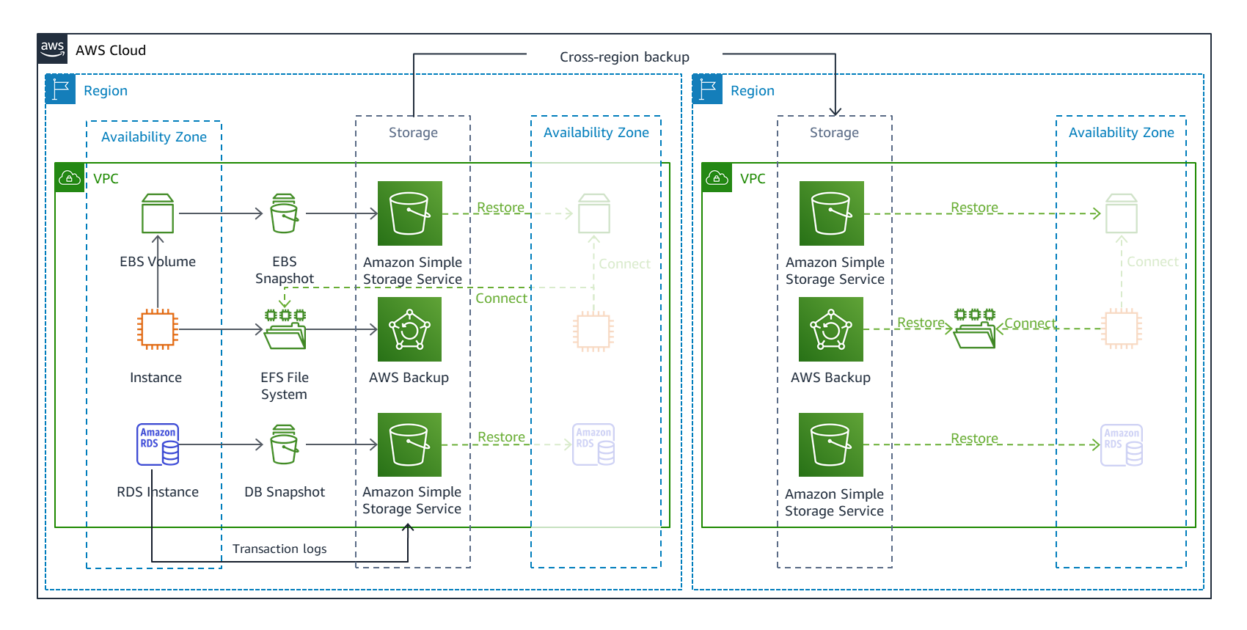
backup and restore

Slide 5
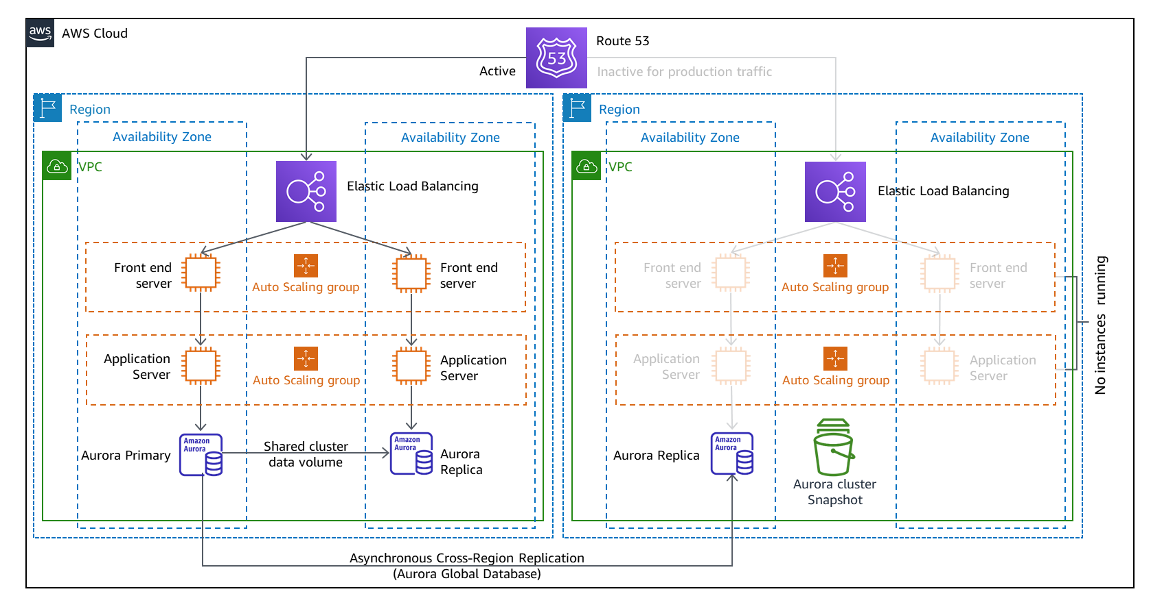
pilot light

Slide 6
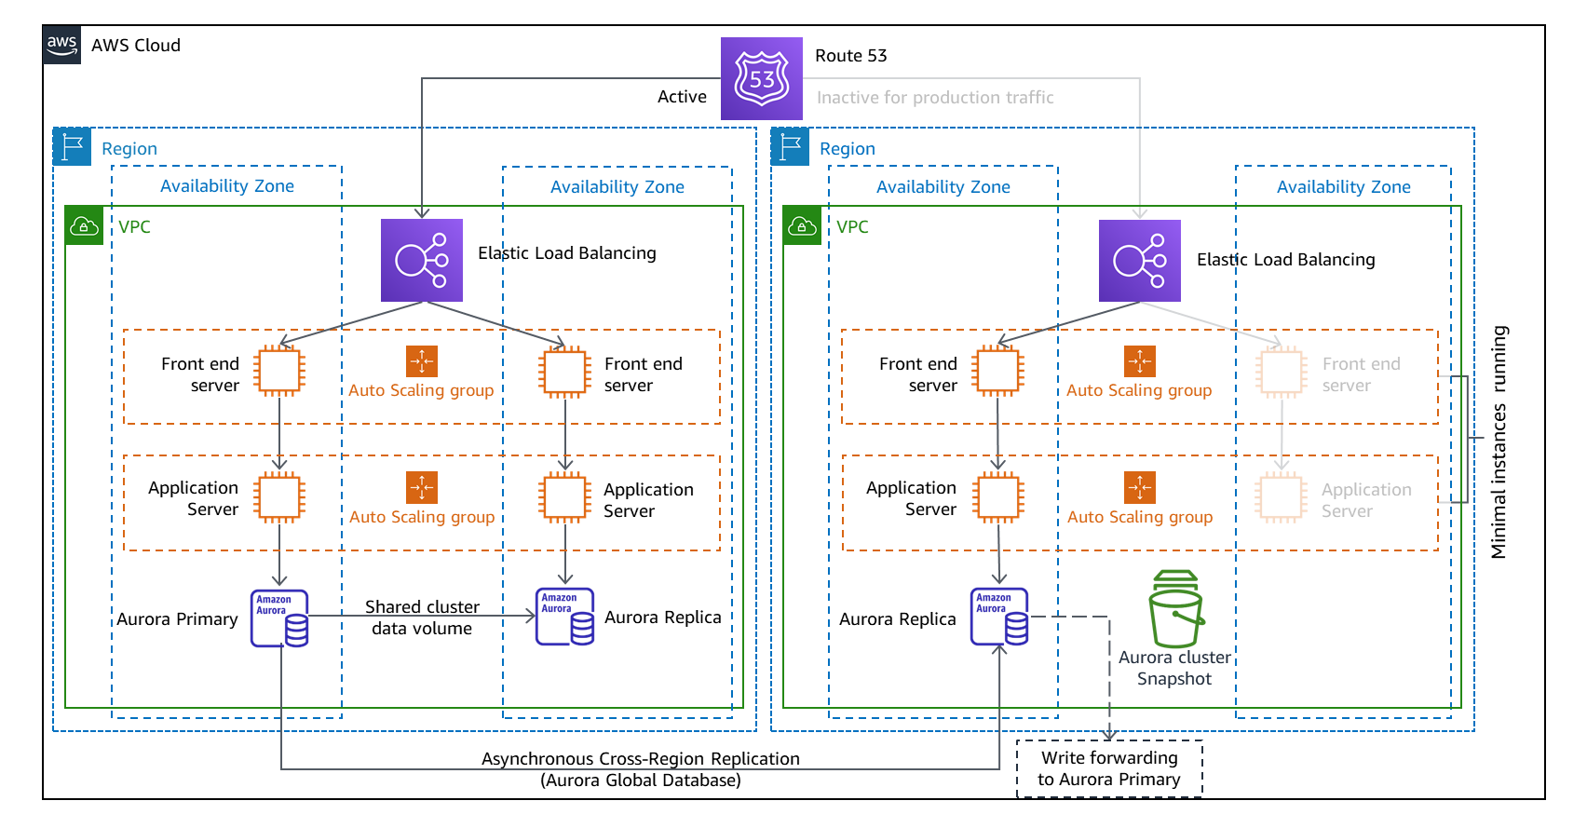
warm standby

Slide 7
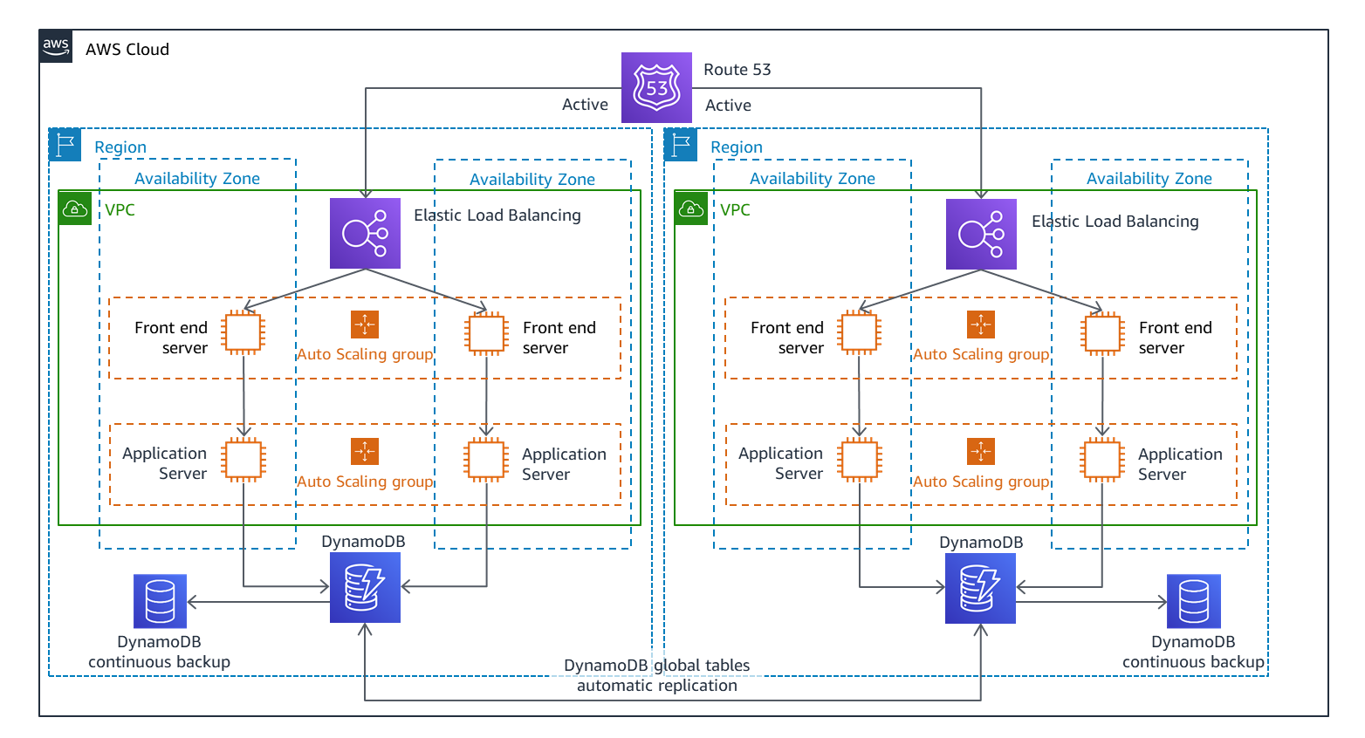
multi-site active-active

Slide 8
Thanks

